Slide 1
The “IT” Factor
Experience means little to me as a Supervisor…EXPERIENCES mean everything…What plays have you seen?
1
The great official has the “IT” factor.
2
The formula for “IT”
3

Slide 2
The Formula for “IT”
(Passion + Confidence + Perspective + Knowledge + Motivation + Humility + Communication)
DIVIDED BY
(Judgment + Professionalism + Appearance + Mobility + Demeanor + Hustle + Approachability)
MULTIPLIED BY
(Availability +Dependability + Coachability + Reliability) + (Courage ) + (Timing)
EQUALS
“IT”

Slide 3
Ejection/DQ Protocol
NCHSAA Handbook Policy

Slide 4
Ejection Criteria Fighting
2 game suspension in Football
4 game suspension in all other sports
Includes kicking, attempting to strike with fist/hand/leg/feet/or equipment
Instigating a fight with an unsportsmanlike act causing an opponent to retaliate
Leaving the bench when there is a fight
Carries same penalty(s) as being in a fight
Substitutes should NEVER leave the bench area to participate

Slide 5
Ejection Criteria Leaving The Bench When There Is Not A Fight
1 game suspension in Football
2 game suspension in all other sports
Remember – Substitutes should NEVER leave the bench area to participate

Slide 6
Ejection Criteria Flagrant Contact
Maliciously running over the catcher/fielder without an attempt to avoid contact
Excessive out-of-bounds or “away-from-the-playing-action” that is unwarranted or extreme in nature
Tackling/contact to the head dangerously in a malicious manner
Illegally hitting or cross-checking an opponent with the stick in Lacrosse
Any flagrant act that is not associated with a legal play associated with that sport
1 game suspension in Football
2 game suspension in all other sports

Slide 7
Ejection Criteria Other
Biting Observed or Determined By An Official
Taunting, Baiting, Or Spitting Toward An Opponent Or Official
Flag/Technical Foul/Technical Violation vs. Ejection
Profanity
The NCHSAA will have Zero Tolerance within the confines of an NCHSAA event for the following: “Profanity of any kind, inappropriate language, racial or ethnic slurs, sexist or homophobic language.”
For the above
1 game suspension in Football
2 game suspension in all other sports

Slide 8
Ejection Criteria Continued Other
Obscene Gestures, Including Gesturing In Such A Manner As To Intimidate Or Instigate
Disrespectfully Address An Official Physically contacting an official is subject to automatic expulsion and can result in ineligibility for remainder of a career
This includes school administrators. Expect/require role modeling excellence from this level of personnel.
For the above:
1 game suspension in Football
2 game suspension in all other sports
“Give the respect you expect…and expect it in return.”

Slide 9
Coach Ejection
Handbook Regulation 2.4.3 (j):
Anytime a coach is ejected from a contest, he/she does not participate the remainder of that day. The coach is also suspended from the next two scheduled, re-scheduled or contracted dates at that level of competition (one in Football) and all games in the interim at other levels of competition.
EXAMPLE: JV coach ejected from game. Misses the next 2 JV games and all Varsity games until the 2-game JV suspension is served.
Handbook Regulation 2.4.3 (k):
The coach is not permitted to be at the game during his/her suspension. A student who is ejected is allowed at the game site but may not be dressed in uniform.

Slide 10
Fan Behavior
Deal with it!
This is one of the reasons we identify the Game Administrator on site.
Utilize them as a resource…they should be a “teammate”
Remember – we have identified the Game Administrator to have Zero Tolerance in regards to proper behavior – a role model
An official cannot eject a fan. Go through the Game Administrator and/or security personnel to remove a fan.
Record this and report to your Regional Supervisor and the NCHSAA office (mark@nchsaa.org)

Slide 11
Filing An Ejection Report
Required within 24 hours after completion of the event
$50 fine to the official(s) for failing to complete the Ejection Report(s)
Go to www.nchsaa.org
Click on OFFICIALS
Scroll down ORANGE box on left side of the Officials page
Click on EJECTION/DQ REPORTING
NOTE: Officials must file all Ejection and DQ reports online
PASSWORD: report1

Slide 12
Filing An Ejection Report
A separate Ejection/DQ Report must be filed for each individual who is to be penalized.
Example: If have a fight, must identify the player/number of EACH school and file individual reports
Example: If have multiple players on a team ejected, must file separate reports for each individual
Do not list multiple players/#’s on the same Ejection Report
For an ejection, click on the actual ejection criteria listed on the Ejection Report Form
Comment box available to detail/describe the situation
Please use proper grammar and professionalism when filing in this information

Slide 13
Filing An Ejection Report

Slide 15
Filing A DQ Report

Slide 16
Ejection Criteria Post-Game Ejections
No “free shots” after the game/contest…in fact, there should be enhanced attention given to post-game ejections
These are to be enforced same as in-game ejections.
Do not allow inappropriate language/contact/input after the contest is complete
Coaches and players are expected to role model excellence at all times
“What you permit, you
promote!”

Slide 17
2019 NFHS softBALL Rules Power Point
Rules Changes Major Editorial Changes
Points of Emphasis
Notes:
2019 NFHS SOFTBALL RULES POWER POINT

Slide 18
NFHS Rules Book as e-Books
E-books features:
Searchable
Highlight areas of interest
Make notes
Easy navigation
Adjustable viewing size
Immediate availability
Notes:
The NFHS Rules and Case Book e-books are available for $6.99 each.

Slide 19
NEW NFHS Rules App
Rules App features:
Searchable
Highlight notes
Bookmarks
Quizzes for all sports
Easy navigation
Immediate availability
Free to paid members of the NFHS Coaches and Officials Associations
www.nfhs.org/erules for more information
Notes:
Rules app for all NFHS rules books and case books are available on iTunes and Google Play. Rules books and case books are cross-linked and enabled for searchable content.
App is free to download.
Each book subscription is $6.99.
NFHS Coaches and Officials Association paid members get all books for free.
100% states members get books for free in sports designated by their state.

Slide 20
2019 NFHS sofTBALL RULES CHANGES
Notes:
2019 NFHS SOFTBALL RULES CHANGES

Slide 21
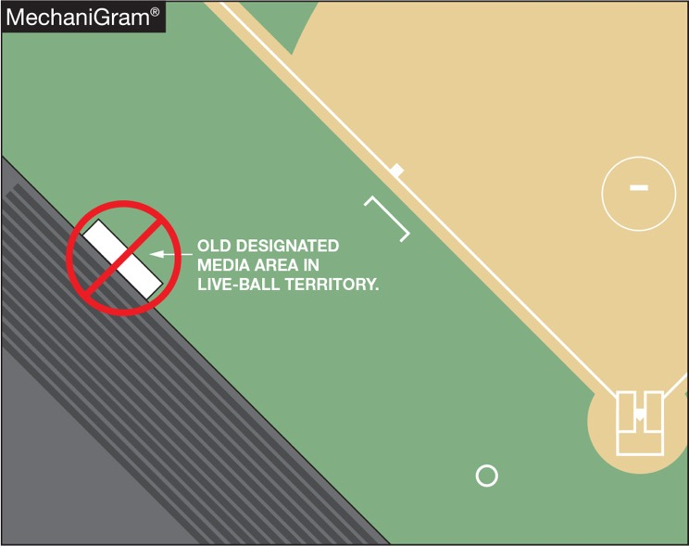
FIELD AND EQUIPMENT Rules 1-1-7, 2-22-4, Table 5-1, 5-1-1o
Media shall be prohibited from being in live-ball areas. The home team or game management may designate an area for the media in dead-ball territory.
Notes:
DESIGNATED MEDIA AREA RULES 1-1-7; 2-22-4 TABLES 5-1; 5-1-1o
Media shall be prohibited from being in live-ball areas. The home team or game management may designate an area for the media in dead-ball territory.
Creating a media designated area in “dead” ball area minimizes risk for players and media personnel. Home team or game management may still designate media areas but not in live-ball area.
Game management may designate a media area in dead ball territory. The change minimizes risk and continues efforts to improve safety of participants and others. The current rule calls for the ball to become dead if the media area is occupied. The possibility that any given area is a dead ball area only at certain times during a game could create a situation that might be unfair to one team.

Slide 22
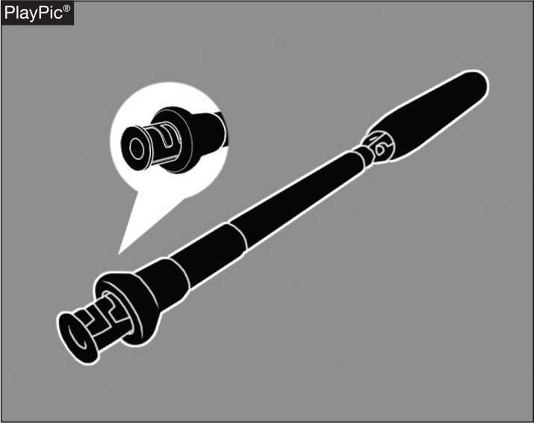
FIELD AND EQUIPMENT Rule 1-5-2a
A softball bat is permitted to have an adjustable knob, provided the knob is permanently fastened by the manufacturer.
Notes:
FIELD AND EQUIPMENT RULE 1-5-2a
A softball bat is permitted to have an adjustable knob, provided the knob is permanently fastened by the manufacturer.
This change clarifies that an adjustable knob is permissible, provided the knob is permanently fastened by the manufacturer.

Slide 23
FIELD AND EQUIPMENT Rule 1-8-4
An eye shield may be worn attached to a defensive player’s face/head protection, but it must be constructed of a molded, rigid material that is clear and permits 100 percent (no tint) allowable light transmission.
Notes:
FIELD AND EQUIPMENT RULE 1-8-4
An eye shield may be worn attached to the face/head protection, but it must be constructed of a molded, rigid material that is clear and permits 100 percent (no tint) allowable light transmission.
Defensive players are permitted to wear a shield on their face/head protection in the field but it must be constructed of a molded, rigid material that is clear and permits 100 percent (no tint) allowable light transmission.
The prohibition of tinted eye shields already exists in NFHS Softball Rules 1-6-7 (batting helmets) and 1-7-1 (Catcher’s Equipment). In an effort to promote risk minimization, tinted eye shields should be prohibited for defensive face/head protection. Rule minimizes risk and is inline with existing NFHS Softball Rules 1-6-7 (batting helmets) and 1-7-1 (Catcher’s Equipment).

Slide 24
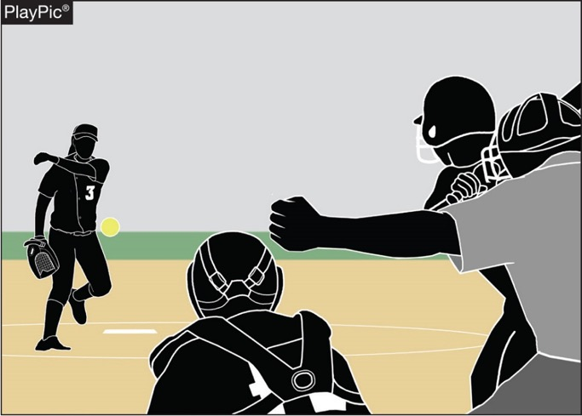
PITCHING RULES 6-1-1 PENALTY, EXCEPTIONS 3 and 4, 6-1-2,3,4 PENALTIES, 6-2-1 PENALTY, 6-2-7 PENALTY
When an illegal pitch is declared by the umpire, the batter is awarded a ball. Previously, the batter was awarded a ball and all base runners were also awarded one base without liability to be put out.
Notes:
PITCHING
RULES 6-1-1 PEN., 6-1-2 THROUGH 4 PEN., 6-2-1 PEN., 6-2-7 PEN.
When an illegal pitch is declared by the umpire, the batter is awarded a ball. Previously, the batter was awarded a ball and all base runners were also awarded one base without liability to be put out.
Language to address the penalty for an illegal pitch was changed. Previously all base runners were advanced one base as well as a ball being called on the batter. The approved change removes the advancement of base runners. Considering that an illegal pitch is designed to hinder the batter, the 2018 NFHS Softball Rules Committee felt that only the batter should receive an advantage from the penalty.

Slide 25
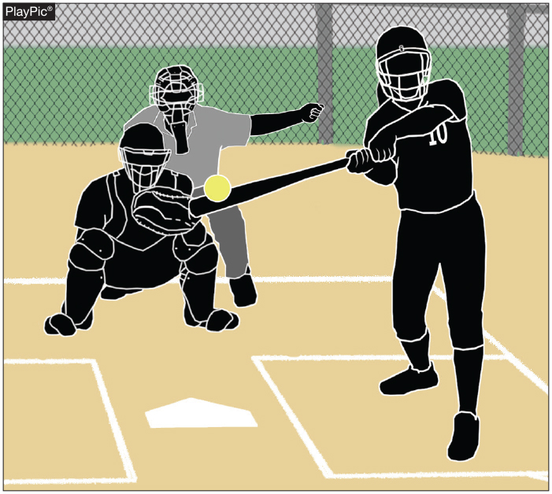
pitching Rule 6-1-1 PenALTY ExcEPTION 1
An illegal pitch remains a delayed-dead ball. If there is an illegal pitch and the batter reaches first base safely and each other runner advances at least one base, the illegal pitch is nullified.
Notes:
PITCHING
RULES 6-1-1 PENALTY EXCEPTION 1
An illegal pitch remains a delayed-dead ball. If there is an illegal pitch and the batter reaches first base safely and each other runner advances at least one base, the illegal pitch is nullified.

Slide 26
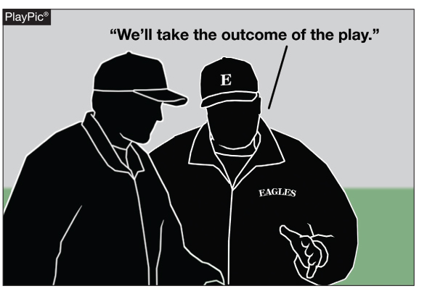
pitching Rules 6-1-1 penalty, ExcEPTION 2
As before under the rules, if the batter does not reach first base safely or any base runner fails to advance at least one base, the coach of the team at bat shall have
the option of the result of the play or the penalty of the illegal pitch, which is a ball awarded to the batter.
Notes:
PITCHING
RULES 6-1-1 PENALTY EXCEPTION 2
As before under the rules, if the batter does not reach first base safely or any base runner fails to advance at least one base, the coach of the team at bat shall have the option of the result of the play or the penalty of the illegal pitch, which is a ball awarded to the batter.

Slide 27
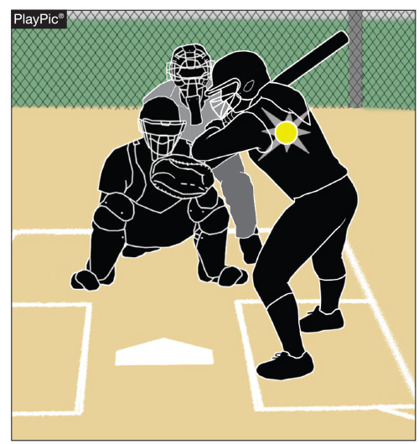
Pitching Rules 6-1-1 penalty EXCEPTION 3
If the batter is hit by an illegal pitch outside the strike zone or ball four is awarded on an illegal pitch, the batter is awarded first base, but there is no longer a one-base award to each base runner.
Notes:
PITCHING
RULES 6-1-1 PENALTY EXCEPTION 3
If the batter is hit by an illegal pitch outside the strike zone or ball four is awarded on an illegal pitch, the batter is awarded first base, but there is no longer a one-base award to each base runner.
The base runners are advanced only if forced.

Slide 28
Pitching Rules 6-1-1 penalty EXCEPTION 4
If ball four is awarded on an illegal pitch, the batter is awarded first base but there is no longer a one-base award to each base runner, unless forced to advance.
Notes:
PITCHING
RULES 6-1-1 PENALTY EXCEPTION 4
If ball four is an illegal pitch, the batter is awarded first base, but there is no longer a one-base award to each base runner.
The base runners are advanced only if forced.

Slide 29
2019 softball Major editorial changes
Notes:
2019 NFHS MAJOR EDITORIAL CHANGES

Slide 30
DEFINITIONS RULE 2-65-2
For the purposes of an appeal:
The intentional walk is considered a time at bat and an appeal of the previous play cannot be made following the intentional walk.
When an intentional walk is awarded by the umpire, it is considered the same as throwing a pitch.
Notes:
DEFINITIONS RULE 2-65-2
For the purposes of an appeal:
The intentional walk is considered a time at bat and an appeal of the previous play cannot be made following the intentional walk.
When an intentional walk is awarded by the umpire, it is considered the same as throwing a pitch.
This change clarifies there can be no appeal of the play that occurred prior to the umpire awarding an intentional walk. The intentional walk allows the batter to be awarded first base without a pitch being thrown. It is, however, considered a time at bat. The pitcher is charged with a base on balls and the batter is awarded first base. The new language includes all plays where the appeal must occur before the next pitch.

Slide 31
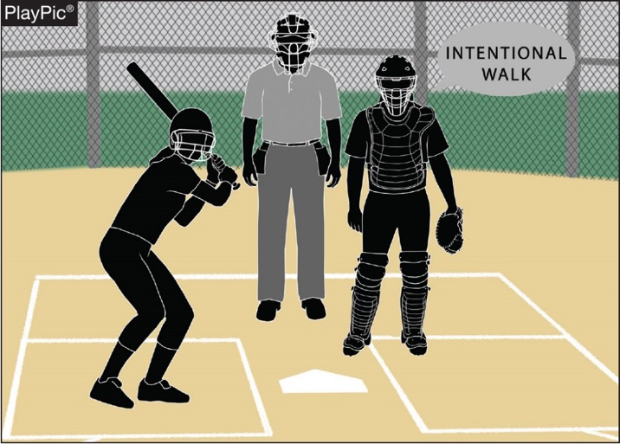
DEFINITIONS 2-65-2
Clarifies that there can be no appeal of a play that occurred prior to the umpire awarding an intentional walk.
Notes:
INTENTIONAL WALK RULE 2-65-2
Clarifies that there can be no appeal of a play that occurred prior to the umpire awarding an intentional walk.

Slide 32
pitchING 6-1-2a, 6-1-2b
Clarifies that the pitch starts when the pitcher’s hands are separated after they have come together while the pivot foot is on or partially on top of the pitcher’s plate. Any step back with the non-pivot foot must begin before the start of the pitch.
Notes:
START OF THE PITCH RULES 6-1-2a, 6-1-2b
Clarifies that the pitch starts when the pitcher’s hands are separated after they have come together while the pivot foot is on or partially on top of the pitcher’s plate. Any step back with the non-pivot foot must begin before the start of the pitch.
This editorial change defines what motion constitutes the start of the pitch and when the step back of the non-pivot foot may be taken. The pitch starts when the hands separate, whether or not the pitcher uses a windup. Any step back with the non-pivot foot must begin before the start of the pitch. Once the pitch has started (the hands separate), the pitcher shall not take more than one step which must be forward, toward the batter and simultaneous with the delivery.

Slide 33
DP/Flex Appendix h
A new appendix was created for quick reference regarding the DP/FLEX rule.
Notes:
DP/FLEX APPENDIX H
A new appendix was created for quick reference regarding the DP/FLEX rule.

Slide 34
APPENDIX H (NEW) DP/FLEX
NFHS Softball - DP/FLEX Simplified REMINDERS:
1) The DP can never be on DEFENSE ONLY.
2) The FLEX player can never be on OFFENSE ONLY.
3) The DP and FLEX player can never be on offense at the same time.
4) The STARTER and the SUBSTITUTE cannot be in the game at the same time.
5) The starting DP and FLEX player have one re-entry just as any other player.
6) Once the game is started with the DP/FLEX positions in the lineup, those positions are available for the entire game.
7) The penalty for illegal re-entry of the DP or FLEX player is always restriction to the bench/dugout.
8) If the player is on offense, she is called out. If the player is on defense, the team on offense may have the choice of taking the result of the play or accepting the penalty.
Notes:
Rationale: An Appendix was added for quick reference.

Slide 35
2019 NFHS softball points of emphasis
Notes:
2018-19 NFHS SOFTBALL POINTS OF EMPHASIS

Slide 36
Simulate taking a sign
The actual signal can be taken while on the pitching plate or while standing behind the pitcher’s plate.
It may be taken from the catcher or coach; it may be a hand signal, a verbal call or may be obtained from looking at her wristband.
However, she must take a position on the pitcher’s plate with the hands separated and simulate taking a signal from the catcher.
Notes:
SIMULATE TAKING A SIGN
The actual signal can be taken while on the pitching plate or while standing behind the pitcher’s plate.
It may be taken from the catcher or coach; it may be a hand signal, verbal call, or may be obtained from looking at her wristband
However, she must take a position on the pitcher’s plate with the hands separated and simulate taking a signal from the catcher.
By rule, the only requirement is that no matter where or from whom the actual signal is obtained, the pitcher must take a position on the pitcher’s plate with the hands separated and simulate taking a signal from the catcher. Requiring the pitcher to take their position on the pitching plate and simulating taking a signal from the catcher prior to bring their hands together allows the batter to prepare themselves for the start of the pitch.

Slide 37
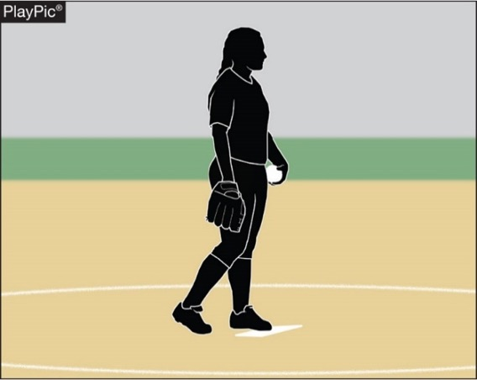
SimulatE taking a sign
If the pitcher does not pause
after stepping onto the
pitcher’s plate to simulate
taking a signal prior to
bringing her hands together,
an illegal pitch should be
called.
Notes:
SIMULATE TAKING A SIGN
if the pitcher does not pause after stepping onto the pitcher’s plate to simulate taking a signal prior to bringing her hands together, an illegal pitch should be called.
While on the pitcher’s plate and prior to bringing her hands together the pitcher must take or simulate taking a signal from the catcher. A signal may be taken from a coach either by hand signals verbal call, or by looking up on a wristband with a playbook/playcard. A signal may be taken from a coach either by hand signals verbal call, or by looking up on the playbook/playcard.

Slide 38
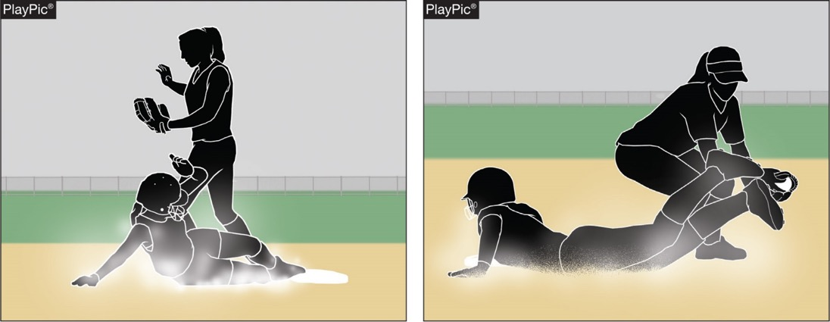
Proper technique when sliding
Coaches are responsible for teaching players proper sliding techniques and how to execute legal slides as defined in Rule 2-52. Proper sliding techniques help reduce potential injuries.
Notes:
PROPER TECHNIQUE WHEN SLIDING
Coaches are responsible for teaching players proper sliding techniques and how to execute legal slides as defined in Rule 2-52. Proper sliding techniques help reduce potential injuries.
One of a coaches’ responsibilities is to help reduce risk and injury to players whenever possible. This includes teaching proper sliding techniques as well as educating their players on executing a legal slide (Rule 2-52).
Ensuring their players utilize proper technique when sliding will help reduce the potential injuries seen when a slide is performed. Ensuring that the slide is performed legally will also reduce the risk to the defender when a tag is being applied to a player sliding into a base.

Slide 39
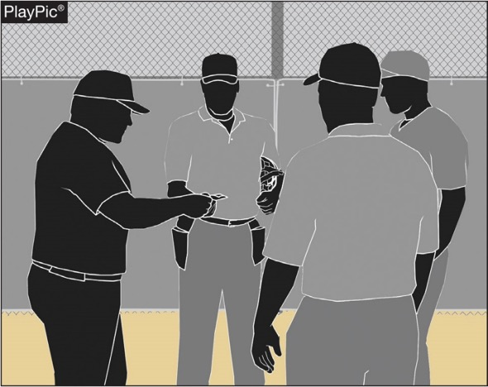
Head Coach listed on lineup card
It is a best practice that the head coach list his or her name on the lineup card submitted at the pregame conference. This will assist both the umpire and the other team if game-related communications are required.
Notes:
HEAD COACH LISTED ON LINEUP CARD
It is a best practice that the head coach list his or her name on the lineup card submitted at the pregame conference. This will assist both the umpire and the other team if game-related communications are required.
Although not a requirement by rule, it is considered a best practice that the head coach list their name on the lineup card submitted at the pre-game conference. By listing their name on the lineup card, it assists both the umpire and other team if communications dealing with the game are required.

Slide 40
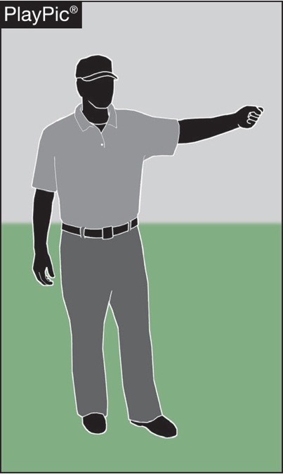
Illegal Pitch Penalty
The penalty to allow the advancement of runners when an illegal pitch is called has been removed.
The intent of an illegal pitch in softball is to deceive the batter, and only the batter should receive an award when an illegal pitch occurs.
Notes:
ILLEGAL PITCH PENALTY
The penalty to allow the advancement of runners when an illegal pitch is called has been removed.
The intent of an illegal pitch in softball is to deceive the batter, and only the batter should receive an award when an illegal pitch occurs.
The NFHS Softball Rules Committee voted to remove the advancement of runners when an illegal pitch is called. Since the intent of an illegal pitch in softball is to deceive the batter, the committee felt that only the batter should receive an award when an illegal pitch occurs. Exceptions to the penalty for an illegal pitch in Rule 6, Section 1, Article 1 have also been modified in order to be in compliance with the new penalty and ensure that runners are no longer advanced as a result of an illegal pitch.

Slide 41
NFHS OFFICIALS Education
Notes:
NFHS OFFICIALS EDUCATION

Slide 42
NFHS Officials Association Central Hub
https://nfhs-softball.arbitersports.com/front/105414/Site
Contains:
Sport information
Rules information
Rules library
Searchable rules book
Video content on officiating sport, competition situations and interpretations
Notes:
NFHS OFFICIALS ASSOCIATION CENTRAL HUB
State associations with 100% membership in the NFHS Officials Association and any individual member has access to the Central Hub for officials.

Slide 43
NFHS Learning Center
Notes:
NFHS LEARNING CENTER
Digital platform for online professional development courses are available on www.nfhslearn.com.

Slide 44
Nfhs learning center www.nfhslearn.com
Professional Development For ALL
Coaches
Officials
Administrators
Parents
Students
Performing Arts
Notes:
NFHS LEARNING CENTER WWW.NFHSLEARN.COM
Professional Development For ALL
Coaches
Officials
Administrators
Parents
Students
Performing Arts

Slide 45
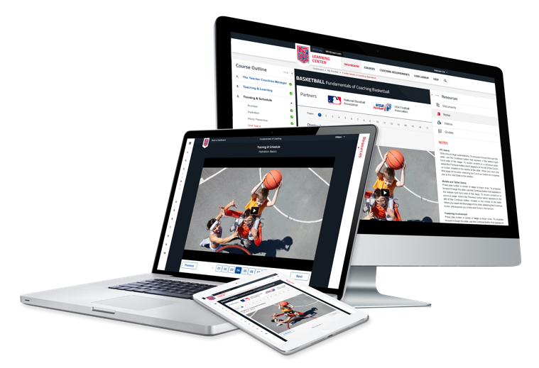
www.nfhslearn.com
FREE courses include:
Bullying, Hazing and Inappropriate Behaviors
Understanding Copyright and Compliance
Hazing Prevention for Students
Concussion in Sports
Concussion for Students
Heat Illness Prevention
Sudden Cardiac Arrest
Sportsmanship
Coaching Unified Sports
Positive Sport Parenting
NCAA Eligibility
Notes:
NFHS LEARNING CENTER WWW.NFHSLEARN.COM
FREE courses include:
Bullying, Hazing and Inappropriate Behaviors
Understanding Copyright and Compliance
Hazing Prevention for Students
Concussion in Sports
Concussion for Students
Heat Illness Prevention
Sudden Cardiac Arrest
Sportsmanship
Coaching Unified Sports
Positive Sport Parenting
NCAA Eligibility

Slide 46
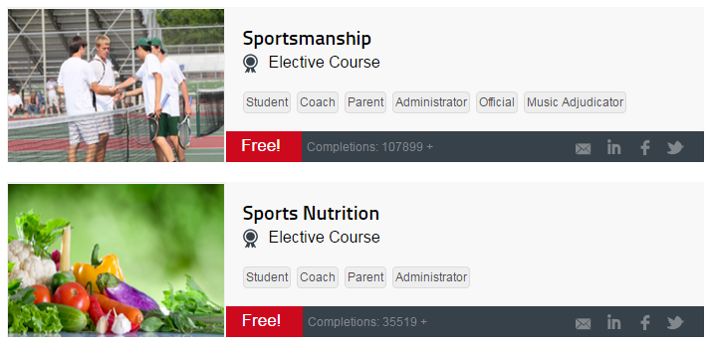
Softball Coaches Education
Notes:
SOFTBALL COACHES EDUCATION
The NFHS partnered with USA Softball to present the online Softball Coaches Course. Go to www.nfhslearn.com to view the trailer, description and outline for this course.

Slide 47
NCHSAA BOARD CHANGES IMPORTANT INFORMATION ELIGIBILITY & COMPLIANCE

Slide 48
Board Changes
Helmets for Coaches
Baseball and softball coaches are required to wear a helmet or skull cap style helmet when coaching in the coach’s box during games, effective for the 2018-19 spring sports season.
The “skull cap helmet” does not have to be NOCSAE certified. The certification is only required when wearing a helmet with ear flaps.

Slide 49
Board Changes
Seeding
At-large berths
4.1.18(e)(1): Teams in their classification will be selected to fill the remaining slots in the bracket based upon conference finish, then MaxPreps ranking.
At-large berth interpretation
Clarified/adjusted interpretation of the rule below to: The highest finishing non-automatic qualifying team in each conference will be compared based on their adjusted MaxPreps ranking. Under no circumstance may a team “leap-frog” a higher finishing team in its own conference.

Slide 50
Board Changes
Seeding
Split Conference Application Adjustments:
4.1.19(b)(1): Removed wording: “...and highest finishing team in each classification of a split conference”
Added note: The highest finishing team in its half of a split conference must finish in 1st, 2nd, 3rd place overall and/or have an overall winning percentage of .500 or higher in order to be seeded as a #1. Otherwise, the team will be seeded with all other at-large teams.

Slide 51
Board Changes
Playoff Contest Starting Times
On Saturdays, if teams cannot mutually agree, the higher seeded team may choose a starting time between 1:00 p.m. and 7:00 p.m.
Start between 1:00 p.m. and 6:00 p.m. if the visiting team is over 100 miles one-way.

Slide 52
Board Changes
Spring 2019 Playoff Calendar
All first round games for baseball, softball, and women’s soccer to be played on Tuesday
All second round games to be played on Friday

Slide 53
Board Changes
Ticket Prices
Increased ticket prices for all playoff rounds, including regional and state championships, across all sports effective July 1, 2018

Slide 54
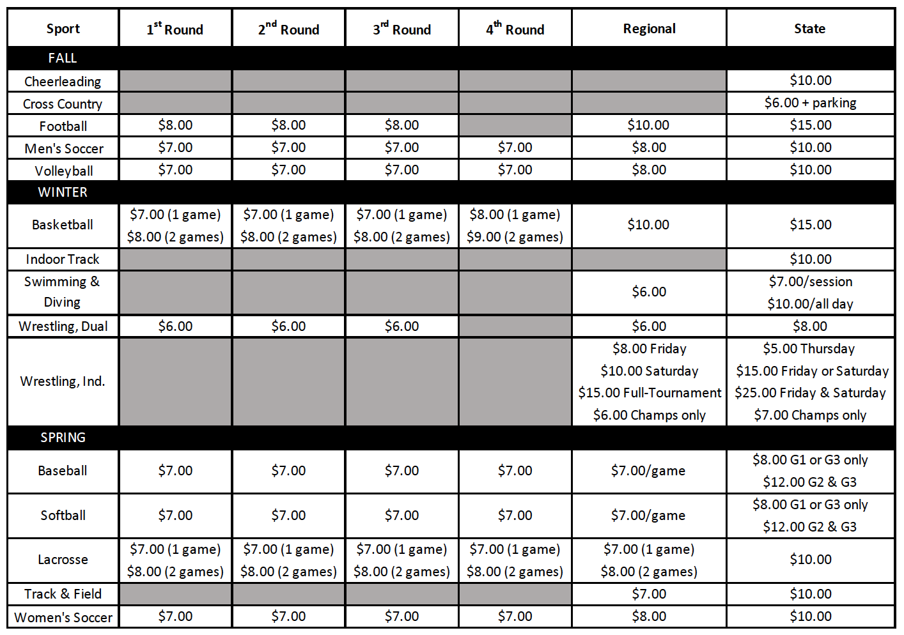
Board Changes
Notes:
This updated chart is in the 2018-19 Handbook.

Slide 55
Board Changes
Transfer Policy
Added language to the Transfer Policy allowing Staff to review all Transfer Certification requests.
“Absent mutual agreement, and in consideration of the above, exceptions for immediate athletic eligibility for transfers from one LEA to a different LEA will first be considered by the NCHSAA Staff, then by the NCHSAA Transfer Committee, if necessary.”

Slide 56
Board Changes
Amateur Rule
Acceptance of money or a forbidden award will cause an athlete to lose athletic eligibility in all sports for 365 days.

Slide 57
Board Changes
Sportsmanship/Ejection Policy
Added language to 2.4.2 (f)
“The NCHSAA will have zero tolerance within the confines of an NCHSAA event for the following: profanity of any kind, inappropriate language, racial or ethnic slurs, sexist or homophobic language”.

Slide 58
Board Changes
Sportsmanship/Ejection Policy Penalties
Added “coaches” to 2.4.3 (c)
“Players or coaches receiving two ejections for unacceptable behavior as defined above will be suspended from all sports for the remainder of that sport season.”

Slide 59
Board Changes
Scrimmages/Ejections Report
Ejections in pre-season scrimmages now require:
Coach/player suspended from the remainder of the scrimmage – inclusive of multiple scrimmage events on same day (jamboree)
Player must complete the NFHS “Sportsmanship” course before being eligible to compete in next scrimmage/contest
Head Coach must complete the NFHS “Teaching and Modeling Behavior” course for any

Slide 60
Board Changes
Video Review for Ejections
When available, NCHSAA staff may utilize video to invoke ejections/sanctions not reported by game officials.
Video clips to be presented for committee review within two (2) business days of the contest.

Slide 61
Board Changes
Officiating Regulations
Added language to 3.3.2(e)(1)
“Schools are to use only NCHSAA-registered officials working through an approved NCHSAA officials association for varsity, junior varsity and ninth grade football, soccer, baseball, softball, volleyball, basketball, wrestling, swimming and lacrosse at events hosted by or contested at the member school.”

Slide 62
Board Changes
Return To Play Form
If a student participating in an interscholastic athletic activity exhibits signs or symptoms consistent with concussion, the student shall be removed from the activity at that time and shall not be allowed to return to play or practice that day. The student shall not return to play or practice on a subsequent day until the student is evaluated by and receives written clearance for such participation from (i) a physician licensed under Article 1 of Chapter 90 of the General Statutes with training in concussion management, (ii) a neuropsychologist licensed under Article 18A of Chapter 90 of the General Statutes with training in concussion management and working in consultation with a physician licensed under Article 1 of Chapter 90 of the General Statutes, (iii) an athletic trainer licensed under Article 34 of Chapter 90 of the General Statutes, (iv) a physician assistant, consistent with the limitations of G.S. 90-18.1, or (v) a nurse practitioner, consistent with the limitations of G.S. 90-18.2.

Slide 63
Board Changes
Return To Play Form
NCHSAA recommends a medical physician!

Slide 64
Board Changes
Home Campus Background and Description
August 2000: Current system built and maintained by local technology vendor
April 2015: Inhouse systems administrator hired
July 2018: Convert all NCHSAA database needs to Home Campus
Current system is functional but:
Lacks centralization
Ability to grow or add new functions
Intermittent access issues based on user’s platform
Notes:
The Board approved a change in the database management system from FileMaker to Home Campus.

Slide 65
Board Changes
Home Campus Scope
The following are 2017-2022 NCHSAA Strategic plans items that will be accomplished by this conversion:
1.1.3 Update the current systems for reporting violations and infractions.
1.2.3.3 Create an interactive tool on the NCHSAA website to help students and parents determine athletic eligibility
2.2.3 Evaluate stakeholder information delivery systems.
2.3.1 Monitor trends in the digital media space, including live video/streaming and social media, and find ways to benefit schools through new technologies.

Slide 66
Board Changes
Home Campus Phase 1 – Existing
The new system will include the following current database functions:
Membership data information (coaches, school information, etc.)
LEA data information
Regional Supervisors data information and clinic scheduling
Sport clinic attendance for coaches
Eligibility summary data entry for each sport season
Endowment games
Transfers
Violations
Sanctions
Ejections/Disqualifications
Seeding for baseball, basketball, golf (regionals), football, lacrosse, tennis (dual team and regionals), volleyball, softball, and wrestling (dual team)

Slide 67
Board Changes
Home Campus Phase 1 – New
The new system will also add the following:
Ability for system athletic directors to search the membership directory as well as monitor the schools in their LEA for compliance.
Ability to have games, rosters and records entered in MaxPreps to be auto-populated in the school’s database.
Ability to have NFHS Learn coach education auto-populated in the school’s database.
Ability to digitize all financial forms such as playoff and endowment game forms.
Ability to export search results to an Excel document for off-line use.
Home Campus also offers many additional features that will be rolled out following stakeholder needs assessments.

Slide 68
Important Information
Dates
1st Practice: Wednesday, February 13th
1st Contest: Wednesday, February 27th
Reporting Deadline: Saturday, May 4th (11:59pm)
Seeding: May 6th
1st Round: May 7th
2nd Round: May 10th
3rd Round: May 14th
4th Round: May 17th
Regional: May 21st - 25th
State Championship: May 31st – June 1st

Slide 69
Dead Periods
Important Information
Summer 2018 | July 2-July 8 and July 16-22
Fall 2018 | July 30 through August 19
Last five (5) days of the first semester
Winter 2018 | Oct 31 through November 20
Last ten (10) days of the second semester
Summer 2019 | July 1-July 7 and July 15-July 21

Slide 70
Important Information
Regular Season Limitations
No more than 23 games, or 24 with one being an approved Endowment Game
Teams and individuals are limited to two games on a school day. The limitation extends to four games, if on a non-school day.
Conference tournaments are not included

Slide 71
Important Information
MaxPreps
Official Statistics Provider
Records and standings for post-season qualifications
Official record
Incorrect record subject to DQ from playoffs
All match results MUST be entered by:
Saturday, May 4th by 11:59 pm
Triple check your record!
Instructions can be found on the NCHSAA website

Slide 72
Important Information
Sportsmanship
The quality of responsible behavior characterized by a spirit of generosity and a genuine concern for opponents, officials and teammates.
Wholesome athletic environment
Good Sportsmanship > Victory
Modest in victory, gracious in defeat
Respecting judgment and integrity of game officials
Role modeling good behavior

Slide 73
Important Information
Ejection Policy
Fighting
Leaving the bench area
Flagrant contact
Biting
Taunting, baiting or spitting toward an opponent or official
Profanity
Obscene gestures
Disrespectfully addressing an official

Slide 74
Important Information
Ejection Follow-Up
Teaching & Modeling Behavior Course
Required for any coach ejected during a contest
Required for any coach who has player (s) ejected for fighting
NFHS Sportsmanship Course
For any ejected/disqualified player
Free, on-line course (nfhslearn.com)

Slide 75
Important Information
Inclement/Hot Weather Guidelines
The following should be considered when scheduling practice:
Time of day
Intensity level of practice
Equipment worn
Environmental conditions
High Temperature and high humidity create a dangerous situation for athletes. High humidity and low temperature can also cause serious heat-related problems.
Water/fluid replacement breaks recommended each 20 or 30 minutes. (depending on practice conditions)
Check with your AD on your LEA’s and school’s policy pertaining to practice on days of extreme heat.

Slide 76
Eligibility and Compliance
Eligibility Video
Required viewing for all coaches
Should be done with the athletic director
Includes opportunities to discuss concussions/sudden cardiac arrests/sickle cell, etc.

Slide 77
Eligibility and Compliance
Preseason Meeting
Required attendance by all parents
Time to share rules, regulations, expectations, philosophy etc.
Time to get all required signatures--pledges, Gfeller-Waller information, etc.
Eligibility and Authorization

Slide 78
Eligibility and Compliance
Coaches Education
NFHS Fundamentals of Coaching Course
All coaches must have satisfied the requirement prior to first contest.
Complete prior to first contest; subject to a $500 fine; continuing to coach without completion = another $500.

Slide 79
Eligibility and Compliance
Coaches Education
Concussion Management Certification
The NFHS Concussion in Sports Course (free on-line course) or an equivalent course must be completed annually (after June 1, 2018 and before the first date of practice) by all coaches.
Prior to the first date of practice for that sport; subsequently, the certificate of completion must be on file at the individual school; subject to $500 fine.

Slide 80
Eligibility and Compliance
Coaches’ Education
CPR/AED Certification
All head and paid coaches must be CPR/AED certified
NFHS Sudden Cardiac Arrest Course
All non-paid coaches are required to complete the NFHS Sudden Cardiac Arrest Course annually (after June 1, 2018 and before the first date of practice).

Slide 81
Eligibility and Compliance
Gfeller-Waller Concussion Law
Requirements
Concussion signs and symptoms
Given prior to participation
Parents/athletes sign indicating “receipt of” Return to Play (RTP) form signed by a physician licensed to practice medicine
An up-to-date Emergency Action Plan (EAP)
Must be on-file, posted and updated annually
“When in doubt, sit them out”

Slide 82
Eligibility and Compliance
Coaches Education
Accredited Interscholastic Coach (AIC) (6th Nationally)
Requires completion of 4 courses:
Fundamentals of Coaching
1st Aid, Health & Safety for Coaches
Sport Specific Course or Teaching Sports Skills
Concussion in Sports (Free)

Slide 83
Eligibility and Compliance
Coaches Education
Certified Interscholastic Coach (CIC) (3rd Nationally)
Completion of AIC requirements PLUS:
Teaching & Modeling Behavior
Engaging Effectively with Parents
Sportsmanship
Creating a Safe and Respectful Environment
Strength & Conditioning
2 additional courses (User Choice)

Slide 84
Thank You!
Get involved with student services programs
Visit the NCHSAA website often
Sign-in/pick-up your card as you leave today

